Slide 1


Fundamentals of RM
RM System and Process
Leadership in RM
Incident Investigation
RM Tools & Challenges
RM in Industry
People & Org.
Application and Perspectives
On Becoming a
Leader in Risk Management
ENGG404 - Lecture
Chapter 2.4
Risk as a Function of
Likelihood and Consequence

Slide 2
Learning Outcomes:
Explain risk as an estimated outcome of two components: consequence and likelihood, and explain each of the components.
Analyze the risks of a typical industrial installation (a high-pressure natural gas transmission pipe-line in operation through a city), and determine the factors that increase the risk.
Chapter 2.4 Risk as a Function of Likelihood and Consequence
2
Notes:
2

Slide 3
Introduction:
Everything we do involves the acceptance of risk …
and we make a decision …
Intuitively, we know what “risk” is …
Let’s think of ourselves as …
jumping out of a plane, a parachutist, a sky-diver
Chapter 2.4 Risk as a Function of Likelihood and Consequence
3
Notes:
3

Slide 4

Do you “feel” the risk?
Consequences?
Likelihood?
Chapter 2.4 Risk as a Function of Likelihood and Consequence
4
Notes:
4

Slide 5

What about now?
Consequences?
Likelihood?
Chapter 2.4 Risk as a Function of Likelihood and Consequence
5
Notes:
5

Slide 6
Our Concept of Risk
Risk is a function of Consequence and Likelihood:
Hazards help inform us about “What can go wrong”
Consequence is “How bad it can be”
Likelihood is “How likely it is to occur”
We estimate both consequence and likelihood to determine “Risk”
How bad
can it be?
What can
go wrong?
How likely
is it to occur?
Risk
Chapter 2.4 Risk as a Function of Likelihood and Consequence
6
Notes:
6

Slide 7
Our Concept of Risk:
Is the Level of Risk acceptable for us to do the activity, or not?
Now that we have estimated the “risk” we decide whether we want to do the activity or not.
Another way of saying it, “Something is “safe” if its risks are judged to be acceptable.”
How bad
can it be?
What can
go wrong?
How likely
is it to occur?
Risk
Do NOT do
(or stop doing)
the activity.
NO
Is Risk Acceptable?
YES
Do
(or keep doing)
the activity.
Chapter 2.4 Risk as a Function of Likelihood and Consequence
7
Notes:
7

Slide 8
Our Concept of Risk:
If the Level of Risk is NOT acceptable, what can we do to reduce it?
Reduce the likelihood, reduce the consequence, or
eliminate the hazard …
Reduce the consequence
Eliminate the hazard
Reduce the likelihood
How bad
can it be?
What can
go wrong?
How likely
is it to occur?
Risk
Do NOT do
(or stop doing)
the activity.
NO
Is Risk Acceptable?
YES
Do
(or keep doing)
the activity.
Chapter 2.4 Risk as a Function of Likelihood and Consequence
8
Notes:
8

Slide 9
An Example of Risk in an Industrial Operation:
“Operating a high-pressure natural gas transmission pipe-line through a city. (Not construction or maintenance.)”
What are the Sources of Energy?
What is one main risk (one of very few risks) posed by a pipeline?
Acceptable Analysis:
Energy sources: flammable gas and pressure.
One main risk in simplest of terms, is a leak.
A leak originates with a breach in the integrity of the pipe wall by any number of causes.
The leak can result in many other possible outcomes:
  no ignition and dispersal,
  immediate ignition and a fire, or
  delayed ignition and a vapour cloud explosion.
Chapter 2.4 Risk as a Function of Likelihood and Consequence
9
Notes:
9

Slide 10
Factors Increasing Likelihood:
Pipeline Integrity – Initial: Sub-standard condition of pipeline: poor choice or quality of materials of construction; defects during manufacturing or fabrication; damaged during installation
Pipeline Integrity - On-going in Operation: Substandard maintenance practices: lack of planned preventative maintenance, lack of inspection, lack of follow-up on inspection results; Substandard operating practices: excessive pressure, excessive flow-rate, internal erosion, poor controls on impurities; poor cathodic protection, pitting corrosion, gas acidity and humidity; Proximity of activities to the pipeline and non-intended contact and breach of pipeline wall integrity
Chapter 2.4 Risk as a Function of Likelihood and Consequence
10
Notes:
10

Slide 11
Factors Increasing Consequence:
Proximity to high-user areas (residences, schools, etc.) and other facilities.
The potential quantity released in event of a loss of containment.
The presence of a potential ignition source.
Chapter 2.4 Risk as a Function of Likelihood and Consequence
11
Notes:
11

Slide 12
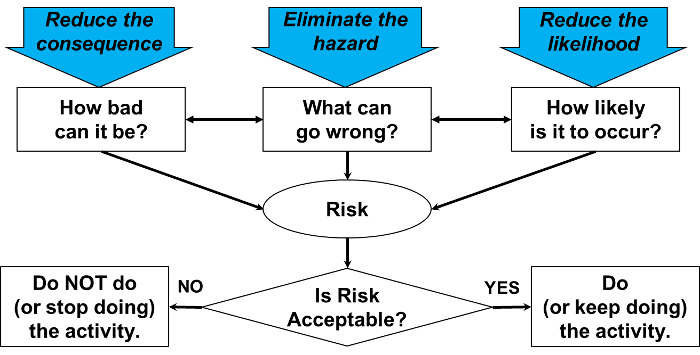
Summary:
Risk is a function of consequence and likelihood.
We derive risks from hazards.
We combine consequence & likelihood to estimate the risk levels.
We focus on hazards, consequences, and/or likelihood factors to understand and explain the risk levels …
THEN we can determine possible ways and means to reduce the Level of Risk.
Chapter 2.4 Risk as a Function of Likelihood and Consequence
12
Notes:
12

